Slide 1
GRADE 7 ACCELERATED · UNIT 4 · LESSONS 7–8
Real-World Order of Operations
MA.8.NSO.1.7
I can substitute values into a formula and evaluate it, reading what the situation does rather than hunting for key words.
Yesterday you read an expression's structure.
Today the expression arrives wrapped in a sentence — and the sentence is not a list of key words.
Grade 7 Accelerated · Unit 4 · Lessons 7–8 — Real-World Order of Operations
1

Slide 2
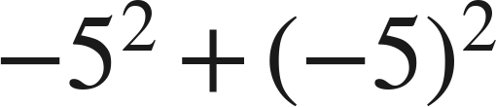
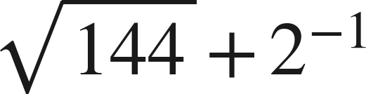
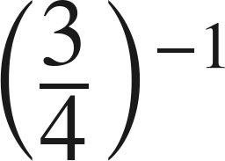


Warm-Up
On your own. Four minutes. No notes.
1.
2.
3. Find the value:
4. Evaluate
when
.
Grade 7 Accelerated · Unit 4 · Lessons 7–8 — Real-World Order of Operations
2

Slide 3
Warm-Up
Answers.
1.
0
2.
25/2
3. Find the value:
4/3
4. Evaluate
when
.
18
Grade 7 Accelerated · Unit 4 · Lessons 7–8 — Real-World Order of Operations
3

Slide 4
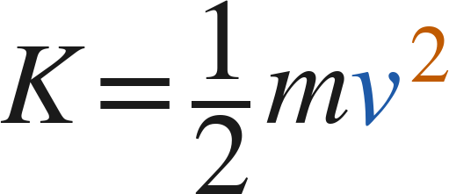


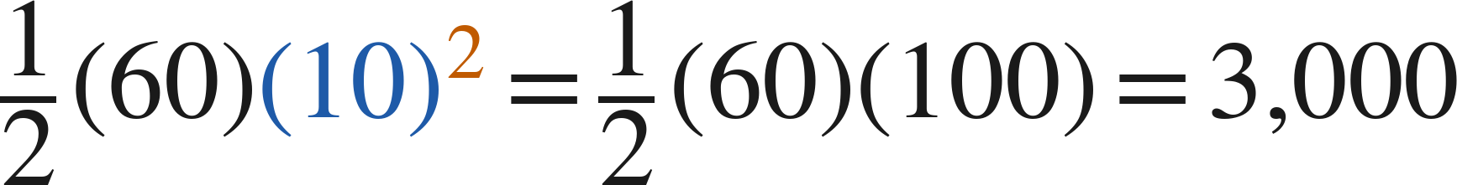

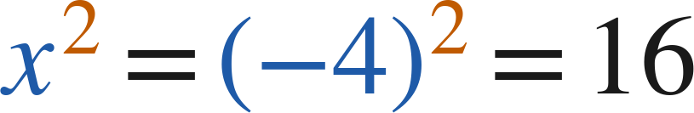
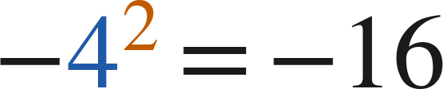
Notes
Copy both lines.
I. Substituting: the value goes in parentheses
with
and
:
joules
with
:
, never
Substitute in parentheses, then evaluate by the structure — powers before products.
Grade 7 Accelerated · Unit 4 · Lessons 7–8 — Real-World Order of Operations
4

Slide 5
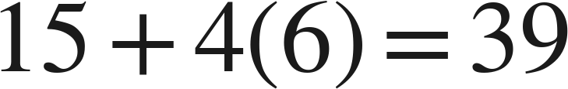
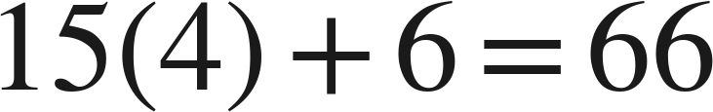
Notes
Copy both problems.
II. Key words do not decide the operation
15 dollars plus 4 dollars for each of 6 gigabytes:
15 dollars for each of 4 lines, plus 6 dollars of tax:
The same words, the same numbers, different structures. Read the situation.
Grade 7 Accelerated · Unit 4 · Lessons 7–8 — Real-World Order of Operations
5

Slide 6
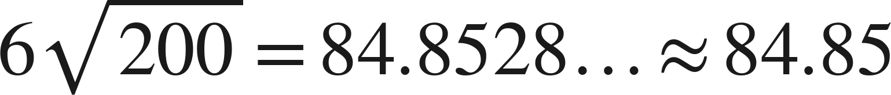

Notes
III. Round once, at the end — and say the unit
feet
rounding the side to 14 first:
feet
Carry the exact value, round once at the end, and write the unit.
Grade 7 Accelerated · Unit 4 · Lessons 7–8 — Real-World Order of Operations
6

Slide 7
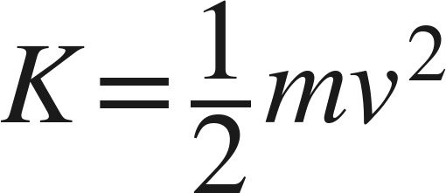



Example 1
A formula with a power in it.
Kinetic energy is
,
for mass
in kilograms and speed
in meters per second.
Find
for a car of mass 1,200 kg travelling at 15 m/s.
Give the answer with its unit.
Grade 7 Accelerated · Unit 4 · Lessons 7–8 — Real-World Order of Operations
7

Slide 8
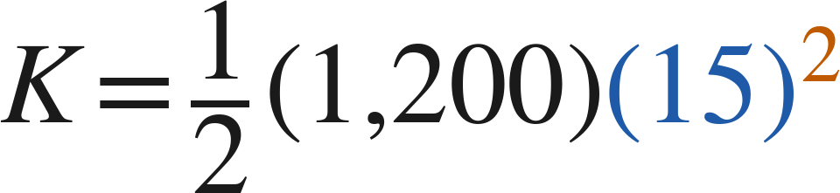
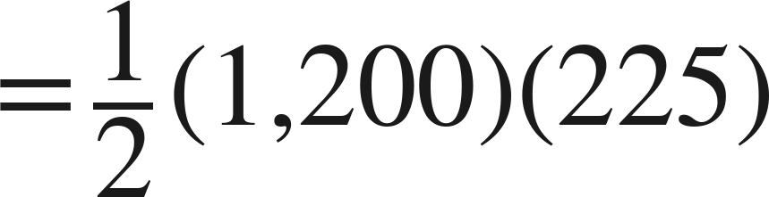
Example 1
Worked.
substitute, each value in parentheses
the power first — it belongs to the 15 alone
then the products
Answer: 135,000 joules
Grade 7 Accelerated · Unit 4 · Lessons 7–8 — Real-World Order of Operations
8

Slide 9


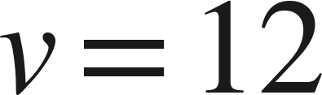
Your Turn
Same steps, your numbers. Boards up when done.
Find
for
kg and
m/s.
Grade 7 Accelerated · Unit 4 · Lessons 7–8 — Real-World Order of Operations
9

Slide 10



Your Turn
Answer.
Find
for
kg and
m/s.
425 times 144
Answer: 61,200 joules
Grade 7 Accelerated · Unit 4 · Lessons 7–8 — Real-World Order of Operations
10

Slide 11
Example 2
A cost with a rate and a flat fee.
A square floor of side 9 feet is carpeted.
Carpet is 2.89 dollars a square foot and padding is 0.75 dollars a square foot.
Installation is a flat 95 dollars. Find the total cost.
Grade 7 Accelerated · Unit 4 · Lessons 7–8 — Real-World Order of Operations
11

Slide 12

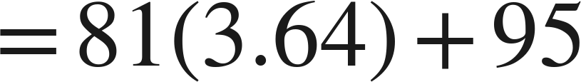
Example 2
Worked.
area times the per-square-foot prices, then the flat fee
the area and the rate, each finished
multiply, then add
Answer: 389.84 dollars
Grade 7 Accelerated · Unit 4 · Lessons 7–8 — Real-World Order of Operations
12

Slide 13
Your Turn
Same steps, your numbers. Boards up when done.
A square bathroom floor of side 6 feet is tiled.
Tile is 4.25 dollars a square foot and grout is a flat 13.48 dollars.
Find the total cost.
Grade 7 Accelerated · Unit 4 · Lessons 7–8 — Real-World Order of Operations
13

Slide 14
Your Turn
Answer.
A square bathroom floor of side 6 feet is tiled.
Tile is 4.25 dollars a square foot and grout is a flat 13.48 dollars.
Find the total cost.
36(4.25) then add
Answer: 166.48 dollars
Grade 7 Accelerated · Unit 4 · Lessons 7–8 — Real-World Order of Operations
14

Slide 15
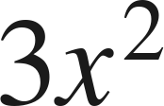

Whiteboards · Question 1 of 9
Boards up on three.
Evaluate
when
.
Answer it.
Substitute in parentheses.
Grade 7 Accelerated · Unit 4 · Lessons 7–8 — Real-World Order of Operations
15

Slide 16
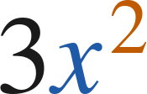

Whiteboards · Question 1 of 9
Answer.
Evaluate
when
.
3(−2)²
Answer: 12
Grade 7 Accelerated · Unit 4 · Lessons 7–8 — Real-World Order of Operations
16

Slide 17


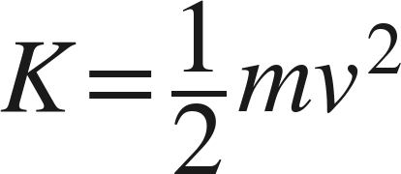
Whiteboards · Question 2 of 9
Boards up on three.
A cyclist of mass
kg rides at
m/s.
Her bicycle cost 480 dollars.
Find her kinetic energy,
.
Answer it.
Grade 7 Accelerated · Unit 4 · Lessons 7–8 — Real-World Order of Operations
17

Slide 18


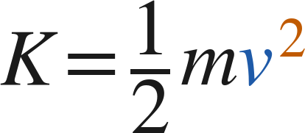
Whiteboards · Question 2 of 9
Answer.
A cyclist of mass
kg rides at
m/s.
Her bicycle cost 480 dollars.
Find her kinetic energy,
.
35 times 64
Answer: 2,240 joules
Grade 7 Accelerated · Unit 4 · Lessons 7–8 — Real-World Order of Operations
18

Slide 19
Whiteboards · Question 3 of 9
Boards up on three.
A plan costs 15 dollars plus 4 dollars for each gigabyte.
Find the cost of 6 gigabytes.
Answer it.
What happens six times?
Grade 7 Accelerated · Unit 4 · Lessons 7–8 — Real-World Order of Operations
19

Slide 20
Whiteboards · Question 3 of 9
Answer.
A plan costs 15 dollars plus 4 dollars for each gigabyte.
Find the cost of 6 gigabytes.
15 + 4(6)
Answer: 39 dollars
Grade 7 Accelerated · Unit 4 · Lessons 7–8 — Real-World Order of Operations
20

Slide 21
Whiteboards · Question 4 of 9
Boards up on three.
A square floor of side 8 feet is tiled at 3.50 dollars a square foot.
Installation is a flat 60 dollars.
Find the total cost.
Answer it.
Which price depends on the area?
Grade 7 Accelerated · Unit 4 · Lessons 7–8 — Real-World Order of Operations
21

Slide 22
Whiteboards · Question 4 of 9
Answer.
A square floor of side 8 feet is tiled at 3.50 dollars a square foot.
Installation is a flat 60 dollars.
Find the total cost.
64(3.50) + 60
Answer: 284 dollars
Grade 7 Accelerated · Unit 4 · Lessons 7–8 — Real-World Order of Operations
22

Slide 23
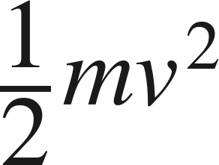


Whiteboards · Question 5 of 9
Boards up on three.
Evaluate
when
and
.
Which is the value?
A. 180
B. 120
C. 360
D. 3,600
Answer it.
Grade 7 Accelerated · Unit 4 · Lessons 7–8 — Real-World Order of Operations
23

Slide 24
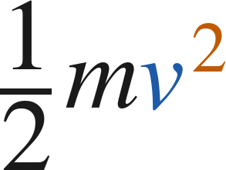
Whiteboards · Question 5 of 9
Answer.
Evaluate
when
and
.
Which is the value?
A. 180
B. 120
C. 360
D. 3,600
Answer: A — 180
Grade 7 Accelerated · Unit 4 · Lessons 7–8 — Real-World Order of Operations
24

Slide 25
Whiteboards · Question 6 of 9
Boards up on three.
A square patio of side 12 feet is sealed at 1.25 dollars a square foot.
Delivery of the sealer is a flat 38 dollars.
Which expression gives the total cost?
A. 12(1.25) + 38
B. 12² + 1.25 + 38
C. 12²(1.25 + 38)
D. 12²(1.25) + 38
Answer it.
Grade 7 Accelerated · Unit 4 · Lessons 7–8 — Real-World Order of Operations
25

Slide 26
Whiteboards · Question 6 of 9
Answer.
A square patio of side 12 feet is sealed at 1.25 dollars a square foot.
Delivery of the sealer is a flat 38 dollars.
Which expression gives the total cost?
A. 12(1.25) + 38
B. 12² + 1.25 + 38
C. 12²(1.25 + 38)
D. 12²(1.25) + 38
Answer: D — 12²(1.25) + 38
Grade 7 Accelerated · Unit 4 · Lessons 7–8 — Real-World Order of Operations
26

Slide 27
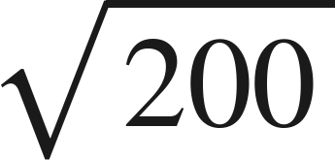
Whiteboards · Question 7 of 9
Boards up on three.
A fence runs along 6 sides, each
feet long.
Find its total length, to the nearest hundredth of a foot.
Answer it.
Round once, at the end.
Grade 7 Accelerated · Unit 4 · Lessons 7–8 — Real-World Order of Operations
27

Slide 28
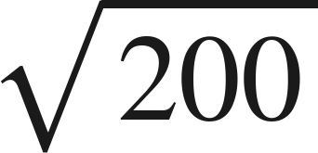
Whiteboards · Question 7 of 9
Answer.
A fence runs along 6 sides, each
feet long.
Find its total length, to the nearest hundredth of a foot.
6 × 14.1421…
Answer: 84.85 feet
Grade 7 Accelerated · Unit 4 · Lessons 7–8 — Real-World Order of Operations
28

Slide 29
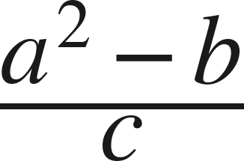



Whiteboards · Question 8 of 9
Boards up on three.
Evaluate
when
,
,
.
Answer it.
Finish the top first.
Grade 7 Accelerated · Unit 4 · Lessons 7–8 — Real-World Order of Operations
29

Slide 30
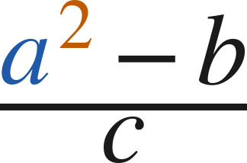



Whiteboards · Question 8 of 9
Answer.
Evaluate
when
,
,
.
45 over 5
Answer: 9
Grade 7 Accelerated · Unit 4 · Lessons 7–8 — Real-World Order of Operations
30

Slide 31
Whiteboards · Question 9 of 9
Take your time. Boards up when you have written it.
A plan costs 15 dollars plus 4 dollars for each of 6 gigabytes.
Another costs 15 dollars for each of 4 lines, plus 6 dollars of tax.
Find both totals, and say why the key words could not have told you.
Write your answer in sentences.
The same three numbers, the same words.
Grade 7 Accelerated · Unit 4 · Lessons 7–8 — Real-World Order of Operations
31

Slide 32
Whiteboards · Question 9 of 9
Answer.
A plan costs 15 dollars plus 4 dollars for each of 6 gigabytes.
Another costs 15 dollars for each of 4 lines, plus 6 dollars of tax.
Find both totals, and say why the key words could not have told you.
39 and 66
Answer: 39 dollars and 66 dollars
Grade 7 Accelerated · Unit 4 · Lessons 7–8 — Real-World Order of Operations
32

Slide 33
Independent Set
Six questions. On your own, in silence.
1.
Six questions. Work down the page.
2.
Show the step that does the work, not just the answer.
3.
Silence until the six minutes are up.
Grade 7 Accelerated · Unit 4 · Lessons 7–8 — Real-World Order of Operations
33

Slide 34
IXL
Last five minutes.
1.
Open IXL and start today's skills.
2.
Work on paper where the question needs work. The answer box does not show it.
3.
Every skill listed is required, to a SmartScore of 67. Due at the start of the next class.
Today's skills — all required
Evaluate variable expressions: word problems — DPG
Grade 7 Accelerated · Unit 4 · Lessons 7–8 — Real-World Order of Operations
34

